Slide 1

Faculty of Sciences Chem241 Ibrahim Abou Zahr 29/10/2022
Department of Chemistry

Slide 2
NaOH
Formation and Uses

Slide 3
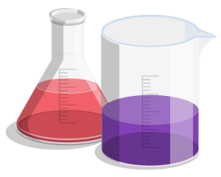
Introduction:
In general chemistry, bases are chemical properties that lose electrons, accept them, or release OH- ions in most aqueous solutions. They oppose the properties of acids but would react with them in several chemical reactions to form salts and catalyze reactions. To start off, one of the various, most important bases found in nature is NaOH.

Slide 4
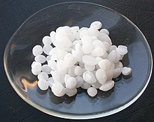
What is NaOH?
Sodium Hydroxide, also known as NaOH, is an inorganic compound that has a white like solid physical feature. It is an ionic compound made of sodium cations Na+ and hydroxide anions OH-. Moreover, it is highly soluble in water (H2O), and highly absorbs carbon dioxide and moisture of any kind. Therefore it is a highly polar chemical.

Slide 5
Chemical and Physical Properties
White Colored
Caustic
Corrosive to skin
Freezes at 15.5°C
Molar Mass: 39.997 g/mol
pH: 13-14 (base)
Part of the Alkali Metal group
Strong Base
Density: 2.61 g/cm^3
Soluble in water
Stable compound
Melting Point: 318. 4°C

Slide 6
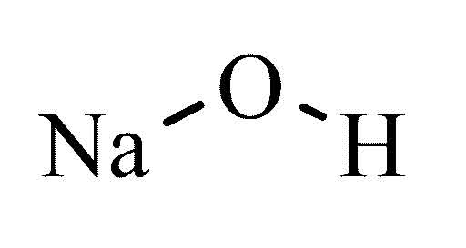
Structural Formula of NaOH

Slide 7
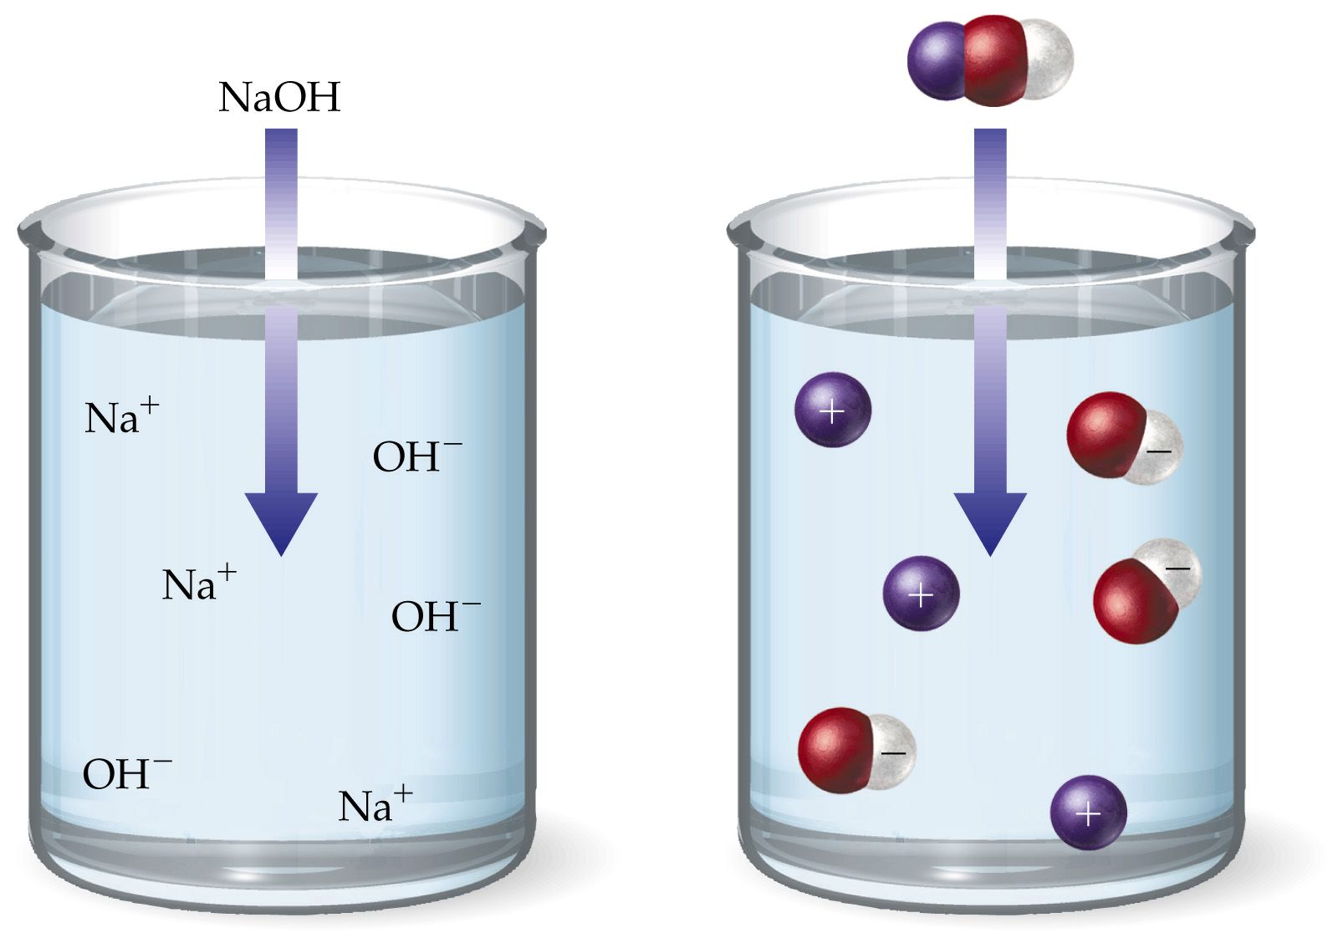
Preparation (1)
In order to prepare 1 M of NaOH solution:
We fill a well cleaned volumetric flask with distilled water.
Add 1.0 M of NaOH.
Add distilled water to reach the 1L mark.
Mix carefully to obtain a 1 M of NaOH solution.

Slide 8
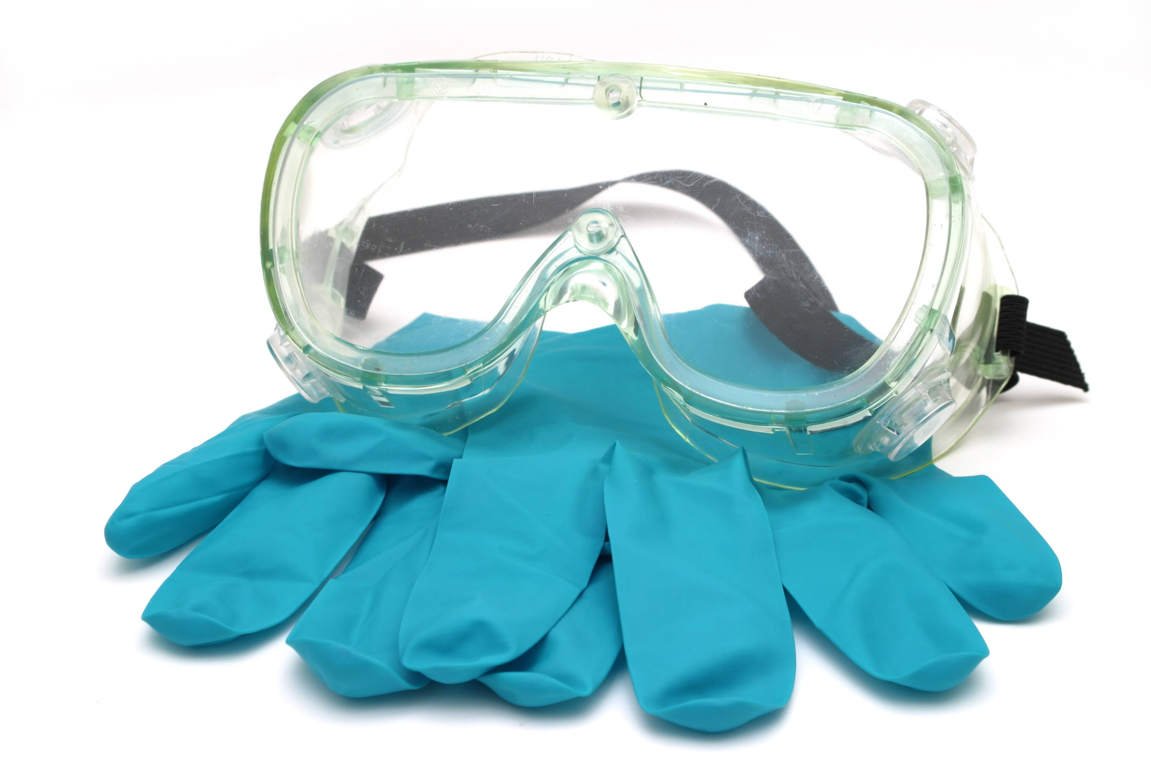
Safety Warning!
It is to be considered that NaOH compound is a caustic solution. Therefore, it is highly recommended to wear safety goggles and gloves before undergoing the preparation. Mainly due to the reason that it may cause chemical burns.

Slide 9
Preparation (2)
NaOH can also be produce using the industrial way:
Sodium hydroxide is produced via the chloralkali process.
By turning sodium ions into sodium metal.
After that we react sodium metal with Mercury to produce Sodium Mercury.
Finally, we hydrate the Sodium Mercury with Hydrogen gas and Hg.

Slide 10
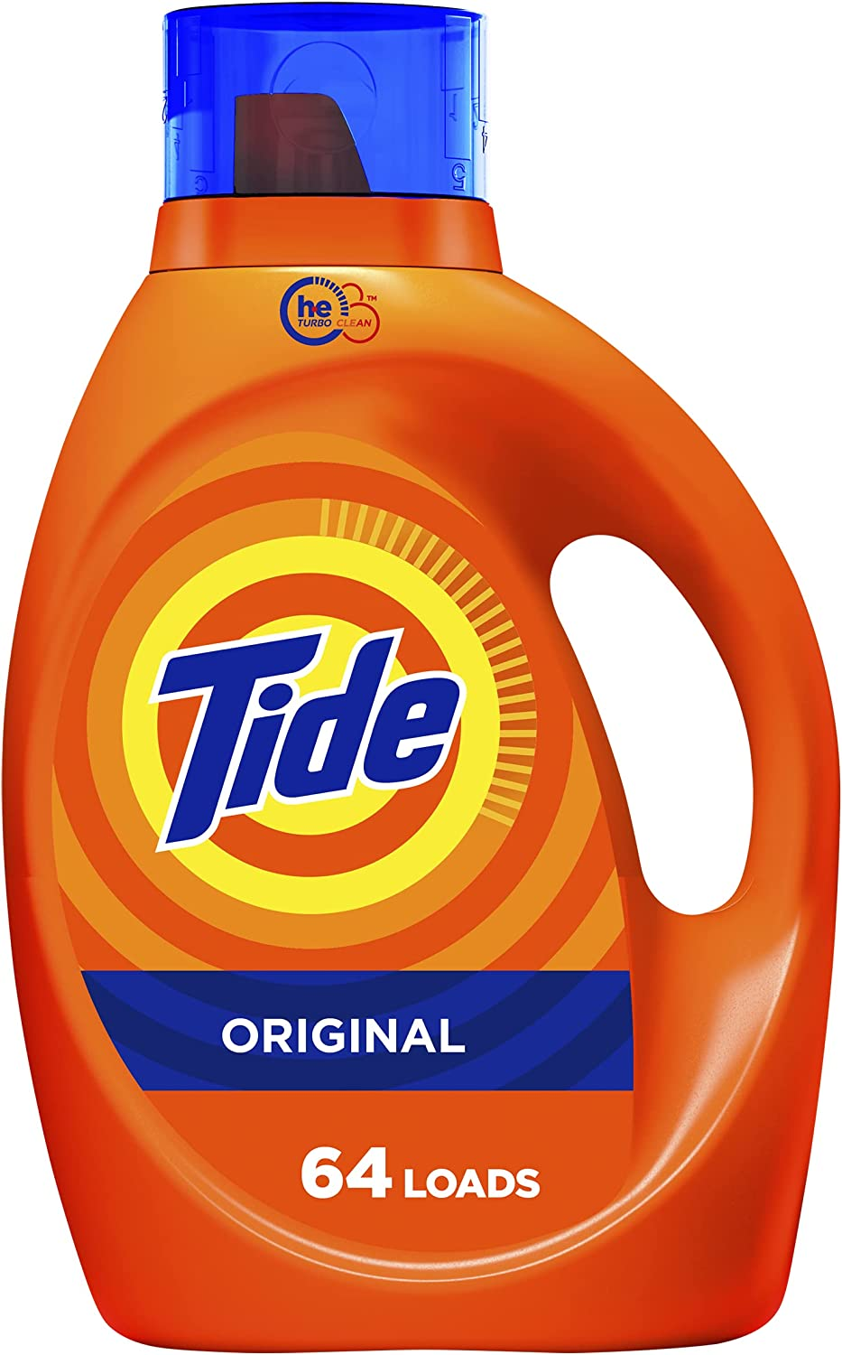

Uses For NaOH
Sodium Hydroxide has a wide range of uses around the world, but most manufacturers use it for the production of dyes, soaps, aluminum, paper, and petroleum products.

Slide 11
Conclusion
In conclusion, we can not deny that NaOH is an essential chemical compound in the lives of the industrial world we live in now. Therefore it is crucial to highlight on it and emphasize it’s importance.

Slide 12
Sources
www.cdc.gov.com
www.protank.com
www.aakash.ac.in

